Slide 1
Linguistics 201
Phonetics 3
Francisco Torreira

Slide 2
Today
IPA
Consonants
Voicing
Place of articulation
Manner of articulation (see O&A 2.5)
Vowels (see O&A 2.6)
Description
English vowels

Slide 3
Dimension 3: Manner of articulation
Different ways of producing a consonant:
Stops: Stopping airflow: [p b t d k ɡ]
Fricatives: Constricting airflow to create turbulent noise [f v θ ð s z ʃ ʒ h]
Nasals: Diverting airflow to another resonator (nasal cavity) [m n ŋ]
Approximants & laterals: Dramatically changing the oral cavity resonator [ɹ/r/l]

Slide 4
Fricatives
Narrow constriction + high air volume velocity gives rise to turbulent airflow, which we perceive as noise
[ɑ s ɑ]

Slide 5
Fricatives
Notes:
- All places of articulation! Voiceless and voiced.

Slide 6
Affricates
Can be understood as a stop + fricative in fast succession = stop with slow release
Always transcribed as stop + fricative
often using tie bar: [t͡ʃ], [d͡ʒ] , to differentiate from [t] + [ʃ]
nutshell vs. ratchet
This class: either [t͡ʃ] or [tʃ] OK for affricate
Notes:
- No row on IPA, but important to know as English (& other languages) has an affricate that acts as one speech sound, not two

Slide 7
Dimension 3: Manner of articulation
Different ways of producing a consonant:
Stops: Stopping airflow: [p b t d k ɡ ʔ]
Fricatives: Constricting airflow to create turbulent noise [f v θ ð s z ʃ ʒ h]
Nasals: Oral stop + diverted airflow to another resonator (nasal cavity) [m n ŋ]
Approximants, lateral approximants: Partial constriction without turbulence [ɹ/r/l]

Slide 8
Nasals
In most speech, the soft palate is raised
Nasal consonants (e.g. [n], [m]) require a lowered velum
During the production of nasal consonants, oral cavity if closed: air flows through nasal cavity

Slide 9


Nasals
vs.
[m]
[b]
Notes:
velum action during labial closure in [m]
Other than that, identical articulation as [b]

Slide 10
Nasals
Notes:
- All places of articulation! Voiceless and voiced.

Slide 11
Dimension 3: Manner of articulation
Different ways of producing a consonant:
Stops: Stopping airflow: [p b t d k ɡ ʔ]
Fricatives: Constricting airflow to create turbulent noise [f v θ ð s z ʃ ʒ h]
Nasals: Oral stop + diverted airflow to another resonator (nasal cavity) [m n ŋ]
Approximants, lateral approximants: Partial constriction without turbulent airflow e.g.
[l]: constriction in oral cavity, but air passes through one or two sides of tongue
[j], [w] involve narrow constrictions, but involve no turbulent airflow, e.g. yacht [jɑt], when [wɛn]

Slide 12
Laterals and approximants
Notes:
- All places of articulation! Voiceless and voiced.

Slide 13
Consonants: Summary
Consonants are classified by their:
Voicing
Glottal state e.g. voiced vs. voiceless
Place of articulation
“Where” pronounced*: e.g. bilabial vs velar
Manner of articulation
“How” pronounced e.g. stop vs fricative
e.g. [p] is a voiceless bilabial stop

Slide 14
Vowels
Articulatory:
More open vocal tract than consonants
voiced
articulated with tongue body
Acoustic:
Louder (than consonants)
Characteristic resonant frequencies (i.e. formant frequencies)
Notes:
Show in Praat

Slide 15
Describing vowels: articulation
Vowel chart is organized according to where highest point in the mouth the tongue is

Slide 16
Vowels
left/right =
unrounded/rounded
IPA chart:
Notes:
Produce contrasts along three dimensions
These are articulatory dimensions, but we’ll see they match acoustic dimensions neatly

Slide 17
Describing vowels: acoustic
Acoustic descriptions are
Accessible (non-invasive)
Accurate
Less accessible to awareness
Shape of the vocal tract determines resonant frequencies of the vowel
we measure and plot the first two resonant frequencies of each vowel
a.k.a first and second formants

Slide 18
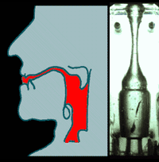
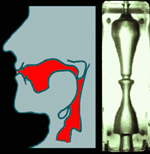


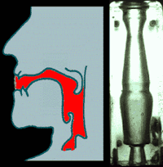
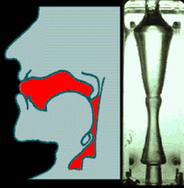
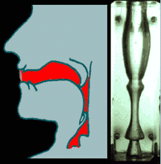
Vocal tract shape (filter) determines vowel quality:
i
u
Sound source
e
o
a
The Source-Filter theory of speech production: Speech sounds modeled as linear combinations of sources and a filters e.g. glottal source + vocal tract filter

Slide 19
Vowel acoustics
Shape of the vocal tract determines resonant frequencies of the vowel
Phoneticians measure and plot the first two resonant frequencies i.e. formants of produced by the vocal tract when investigating vowel qualities

Slide 20
front mid vowels
high back rounded vowels
i
u
First formant (F1)
æ
ɑ
Second formant (F2)
Plotting vowels in F1 + F2 space produces a traditional vowel “quadrangle”:
Notes:
See examples in Praat

Slide 21
Characterizing vowels
When describing vowels we specify:
height
backness
rounding
nasality (if not specified, assume oral)
length (if not specified, assume short)
Ex: [i] is a high front unrounded vowel
refers to position of tongue body
refers to position of lips

Slide 22
Monophthongs (e.g. [i])
a.k.a. ‘simple’ vowels
position of the articulators is relatively constant
Diphthongs (e.g. [aj], [ow])
sequence of vowel + glide or glide + vowel
articulation involves a noticeable change
But count as one segment only

Slide 23
Monophthongs and diphthongs
Examples: some North American vowels
In this class, diphthongs count as one segment even if we use two symbols
Word | Monophthong | Word | Dipthong
“he” | [ hi ] | “hay” | [ hej ]
“who” | [ hu ] | “hoe” | [ how ]
“had” | [ hæd ] | “hoy” | [ hoj ]
“haw” | [ hɑ ] | “high” | [ haj ]
 |  | “how” | [ haw ]

Slide 24
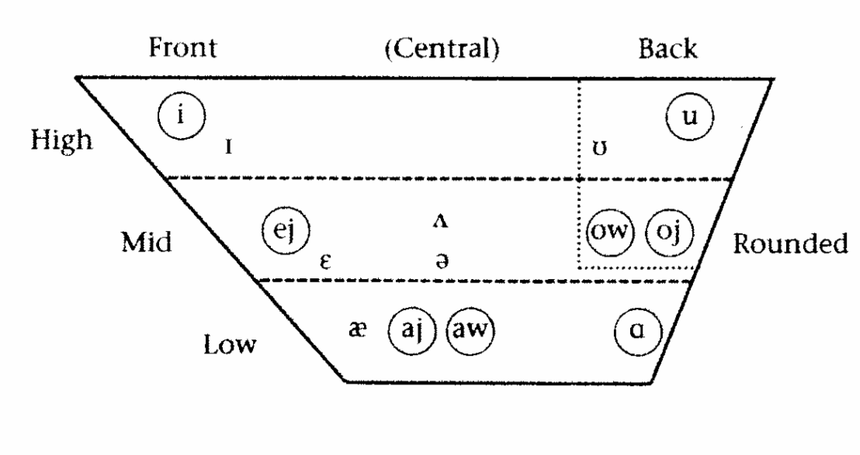
Canadian English vowels
Circles around tense vowels; you can ignore this distinction in this unit

Slide 25
Characterizing vowels
When describing vowels we specify:
height
backness
rounding
nasality (if not specified, assume oral)
length (if not specified, assume short)

Slide 26
Oral and nasal vowels
Oral vowels:
velum is raised
airflow/sound only through oral cavity
Nasal vowels:
velum is lowered
airflow/sound is through both oral and nasal cavities

Slide 27
Oral and nasal vowels
English vowels may be nasalized contextually before nasal consonants, but nasality is not involved in meaning contrasts as those in the French examples
[ vejn ]
[ bown ]

Slide 28
Characterizing vowels
When describing vowels we specify:
height
backness
rounding
nasality (if not specified, assume oral)
length (if not specified, assume short)
Ex: [i] is a high front unrounded vowel

Slide 29
Next time
Prosody
Stress
Tone
Intonation

